Slide 1
The Production of
Peculiar Pet Adventures
Notes:
give a presentation where you introduce the game, and talk about what technically challenging components your game contains and how you approached them (5 minutes)

Slide 2
Getting Started
Game Style
Main Idea
Theme
Target audience
Main Elements
Story

Slide 3
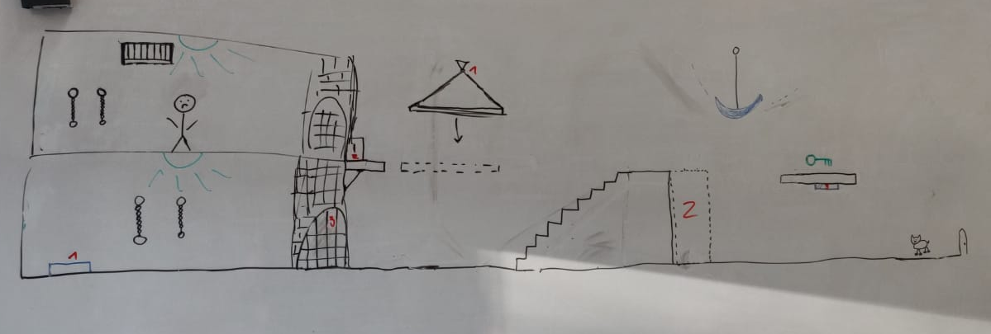
Level design

Slide 4
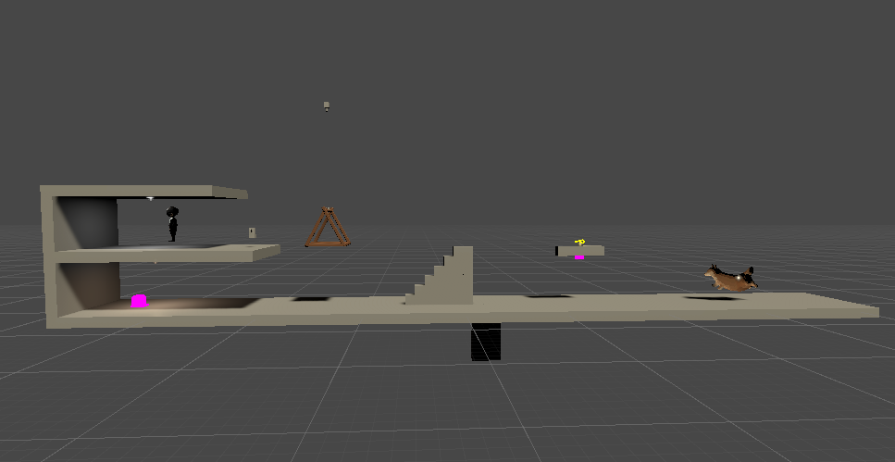
Level design

Slide 5
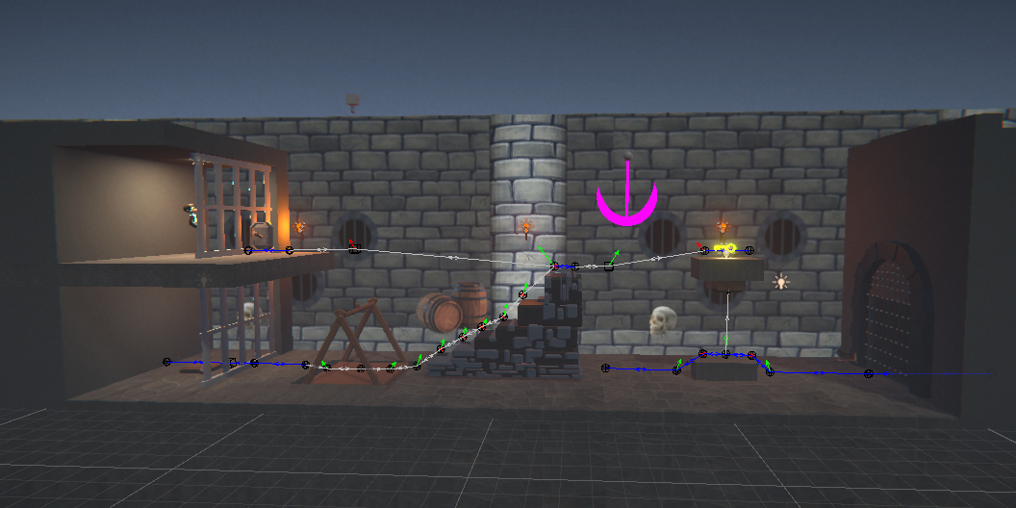
Level design

Slide 6
Gameplay and mechanics
Pathfinding Algorithm
Pet Command System

Slide 7
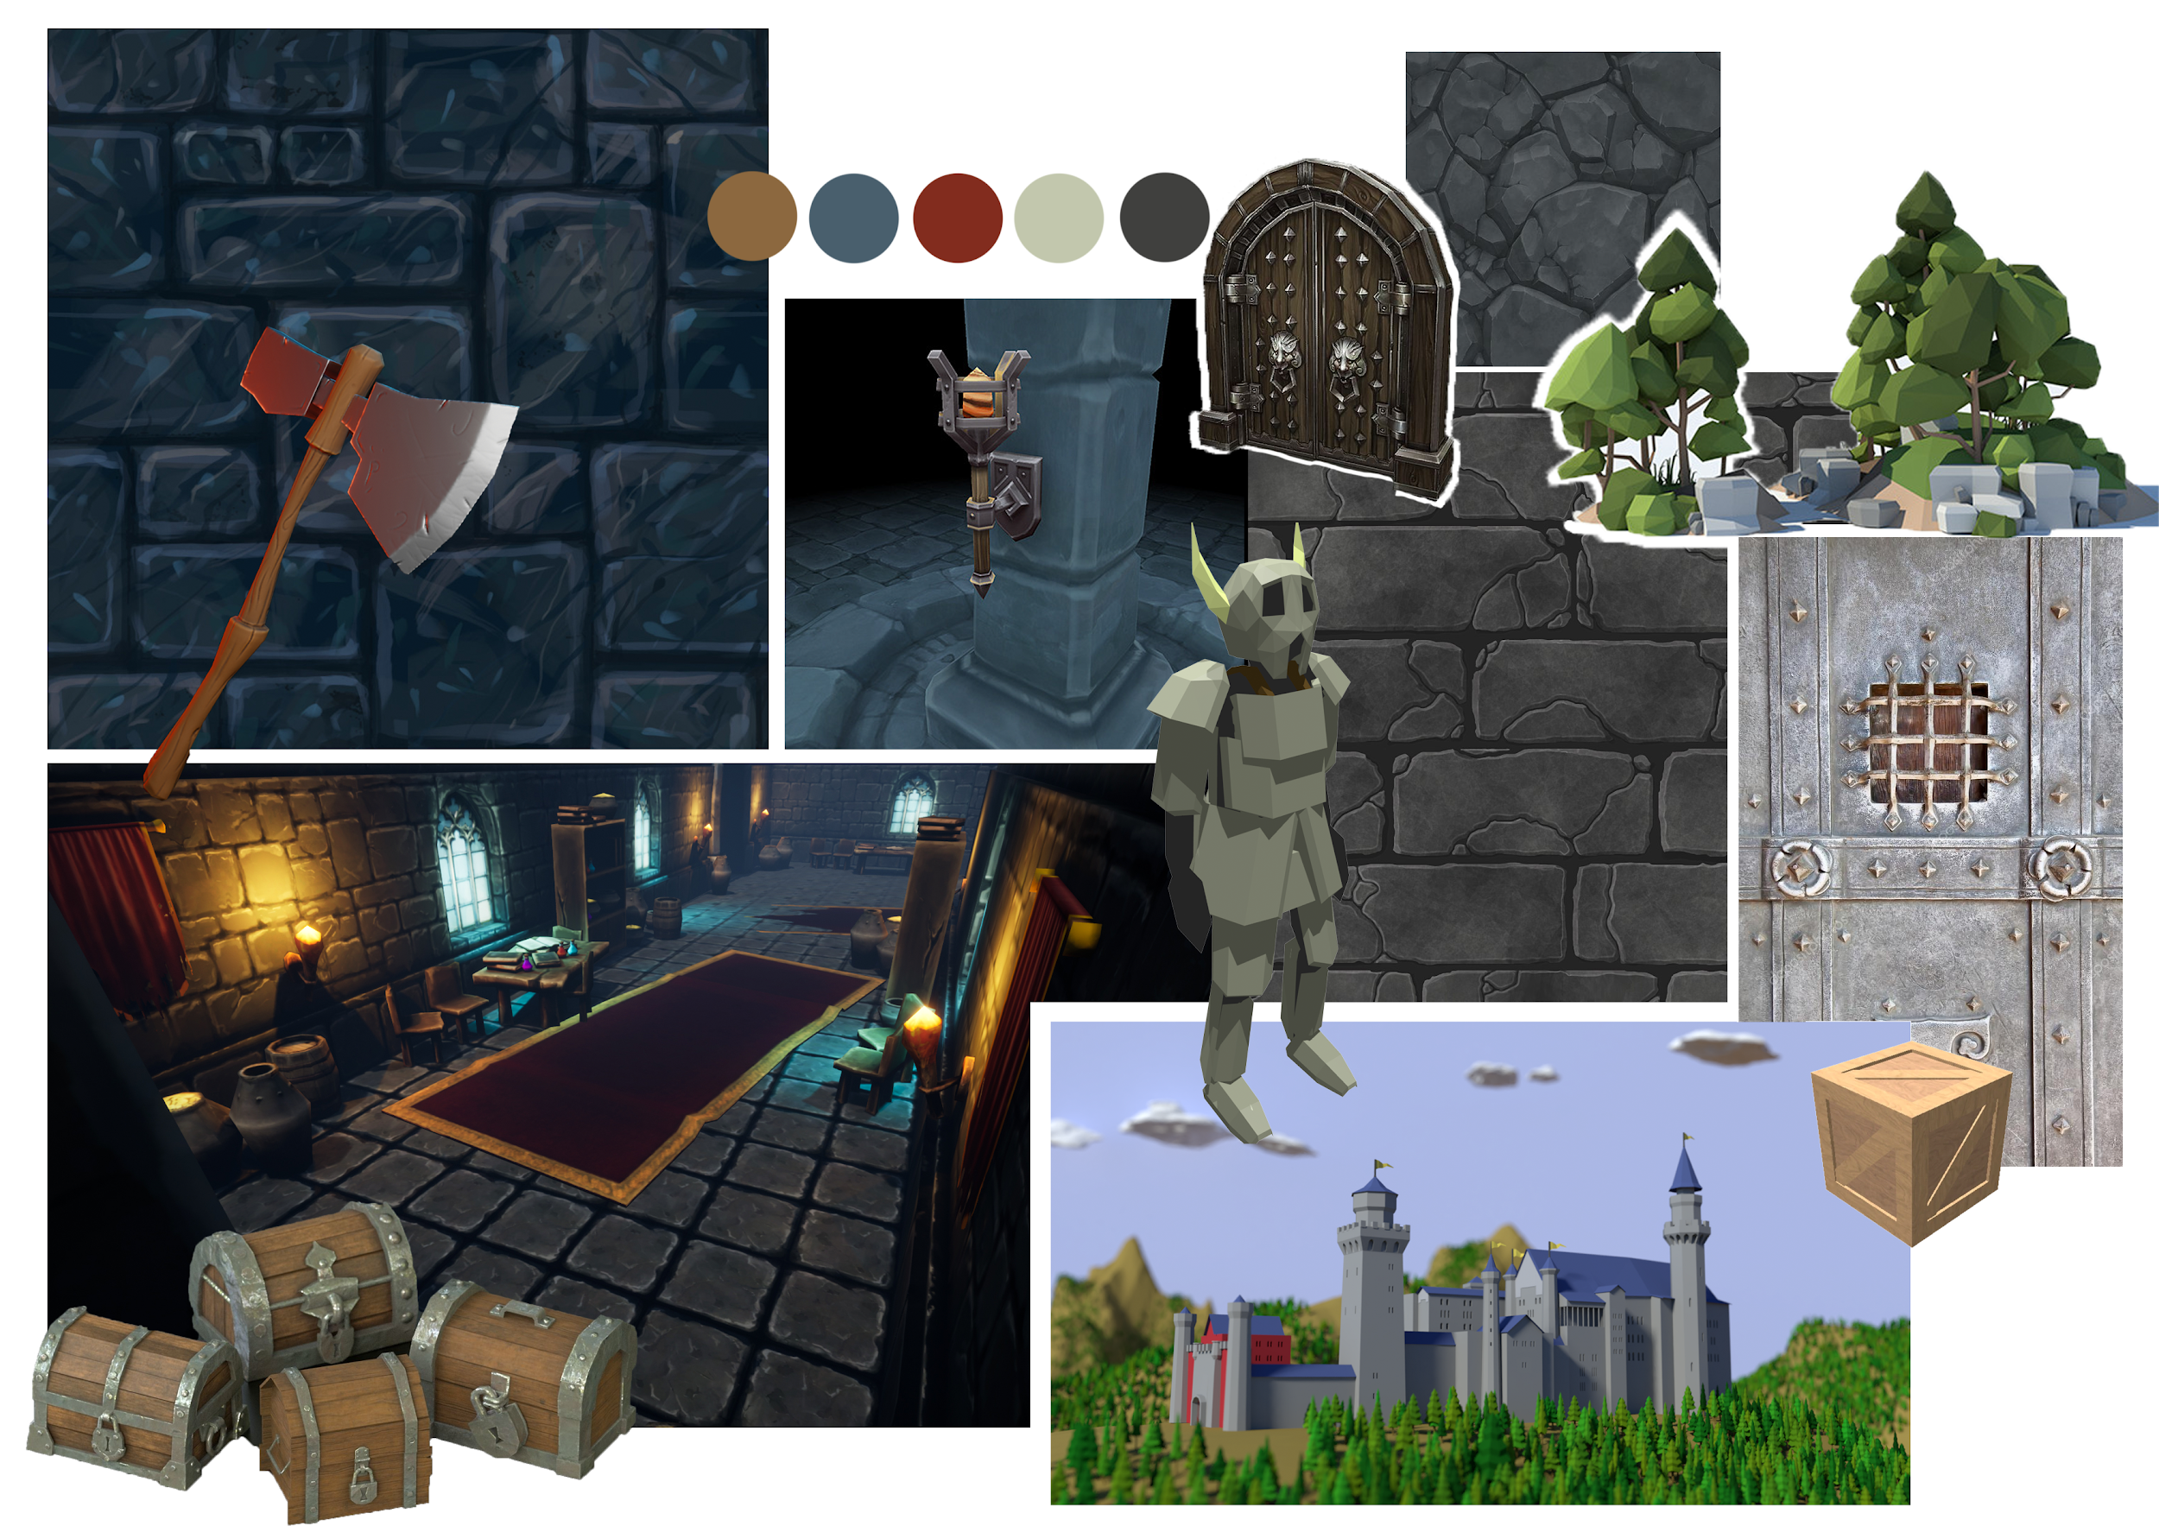
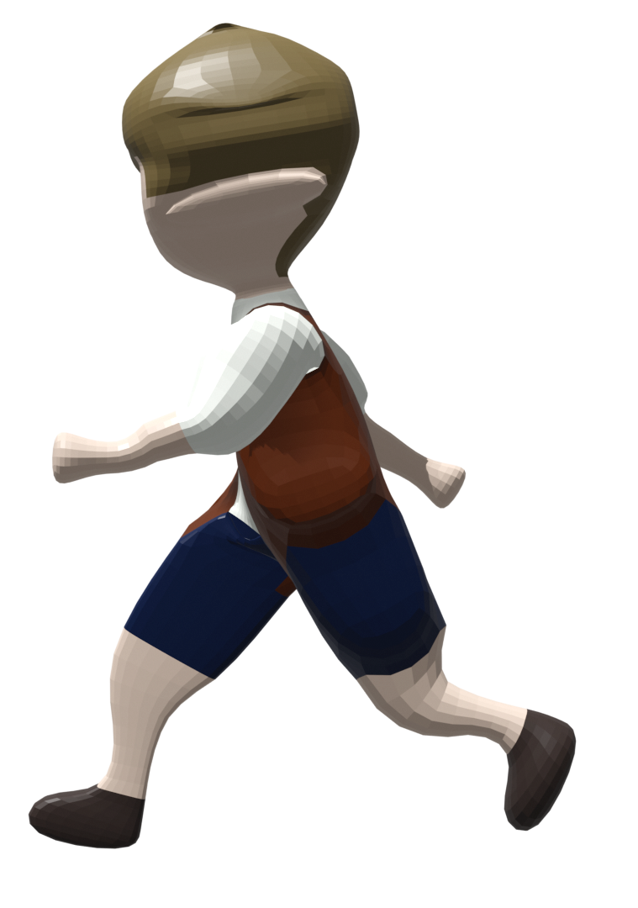
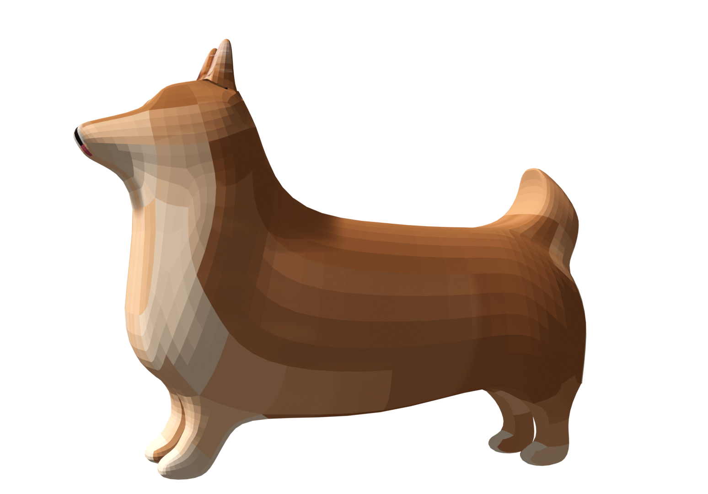
Art
Low poly cartoon style
Main colors
Castle elements
Notes:
Fit the target audience 7+, kids.
Takes place in a castle, the main color is gray, dark blue, a lot of cold colors.
Used a lot of texture of bricks in the game
Our 3d models of the main characters fit the collage very well

Slide 8
Sound
Basic sound effects for interactables
Randomized sound effects
Background music: Castle, Fantasy
Notes:
Interactables: buttons, pulley handle, pressure plate (add photo)
Randomized Sound effects for door open, pendulum, key, moving platform
The background music creates an atmosphere of a castle and fantasy world

Slide 9
Future Implementations
Implement story in game
Create more levels
More character animations
Add difficulty levels
Notes:
Magic forest levels
More character animations when interacting with objects

Slide 10
Questions?

